Slide 2



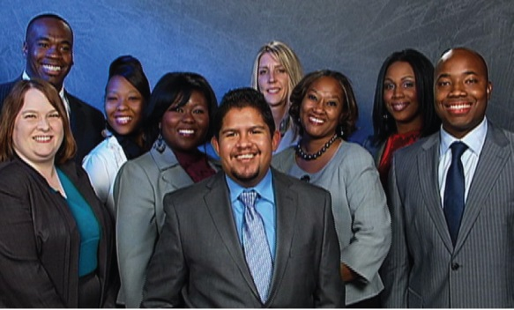
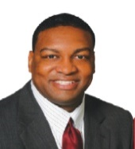
STAND
lead· er·ship
Our mission is to empower individuals and organizations through leadership training.
standone.com
Increase Earning Potential | Improve Leadership Skills | Enhance Community Service
TAKE A STAND TODAY!
ENROLLING NOW!
“Joining The STAND Foundation could be the best decision one will ever make!”
Tracy Steele, Founder
The STAND Foundation, Inc.
FOUNDATION, INC.
We Build Leaders.
501.374.8788 | standone.com

Slide 3

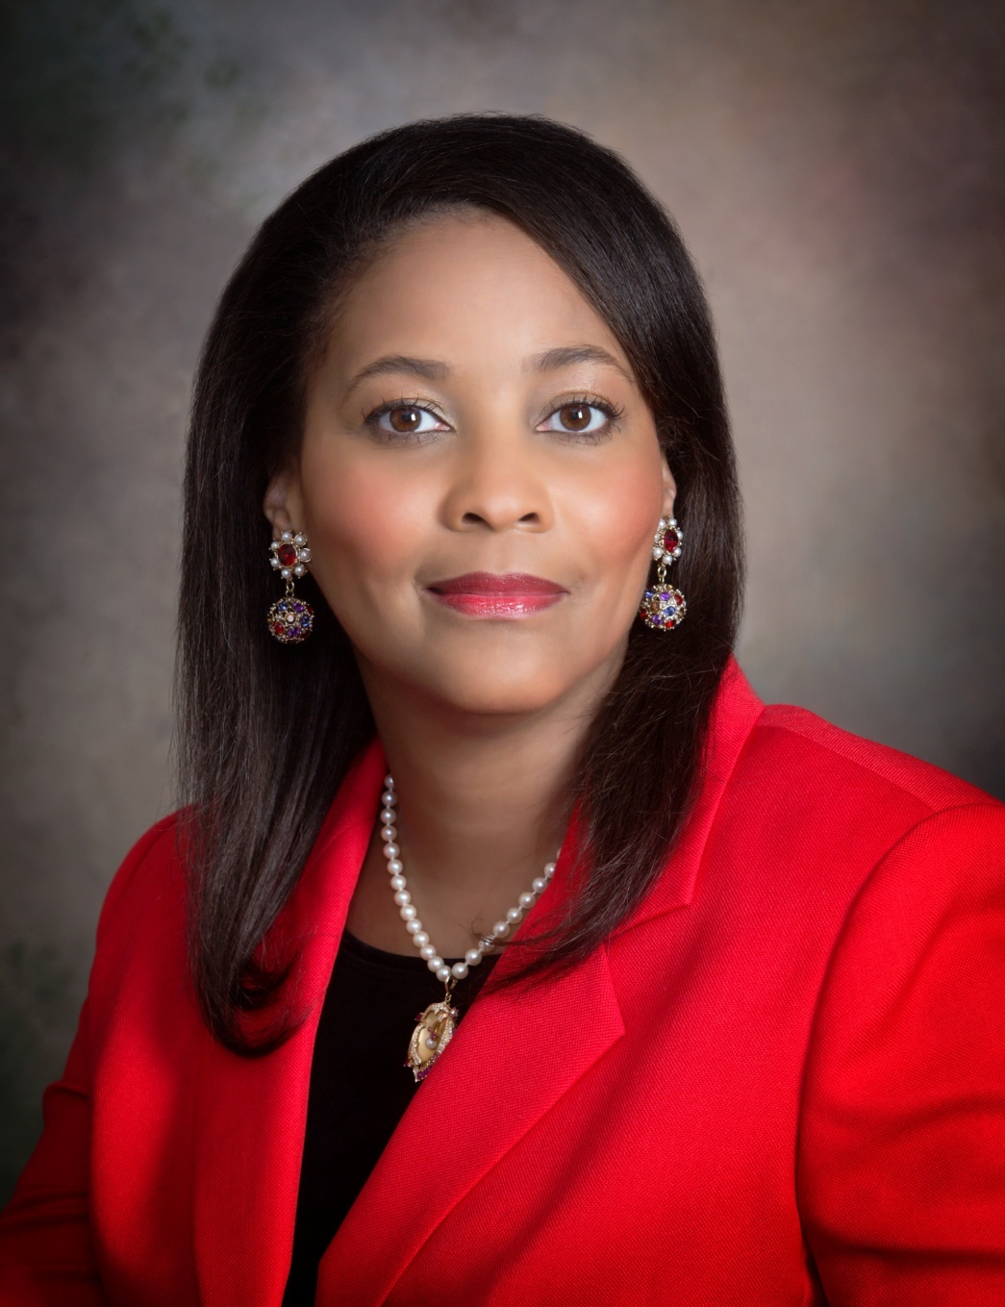
Dr. Michele R. Wright

Slide 4
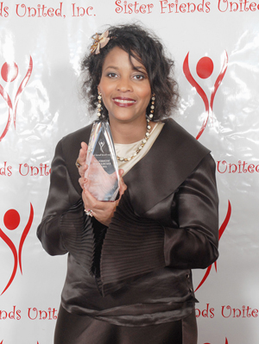

Slide 5
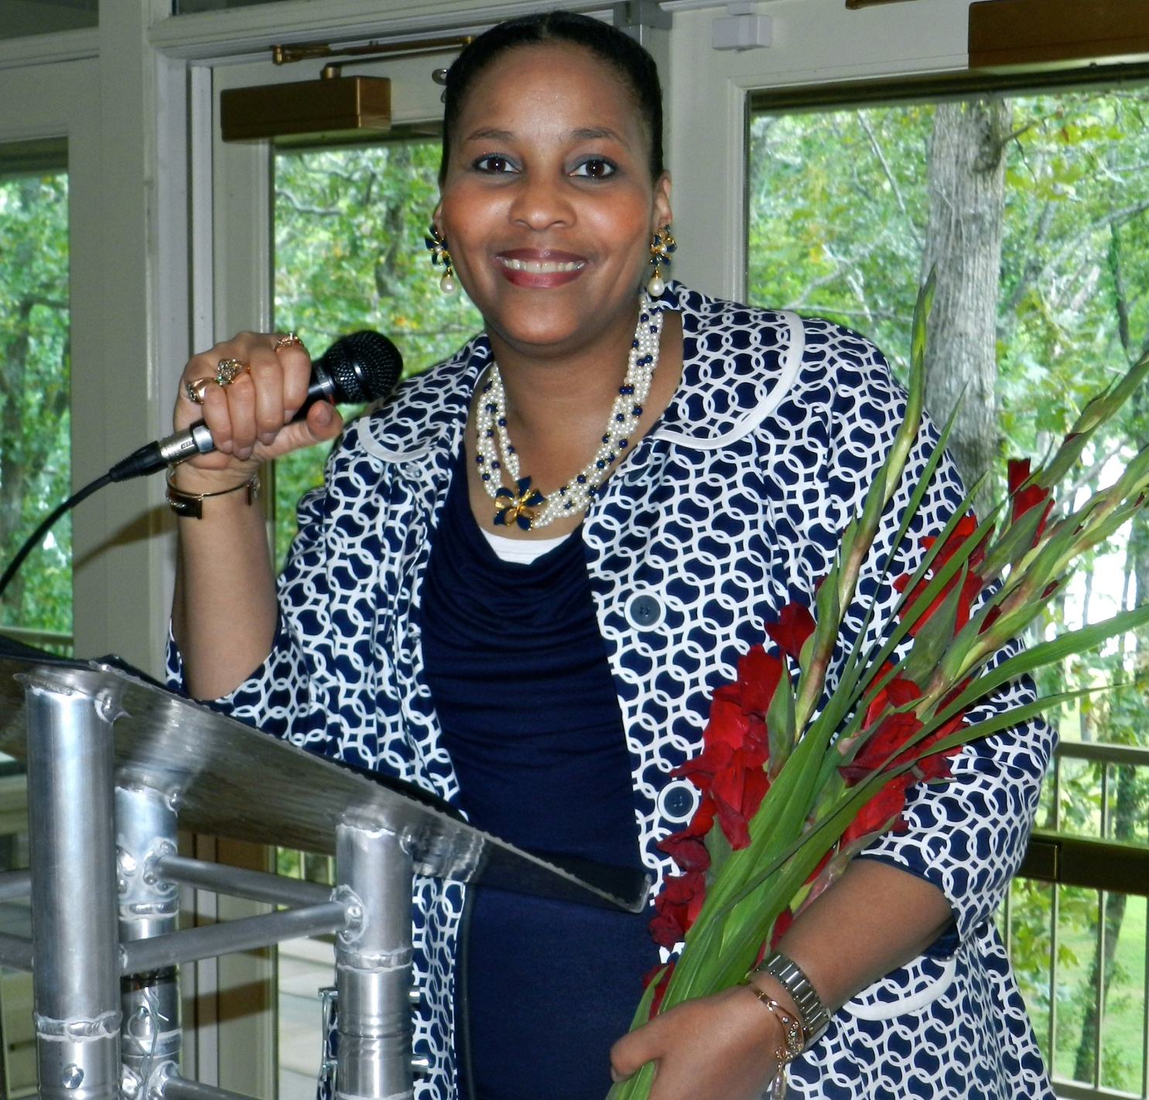

Slide 6
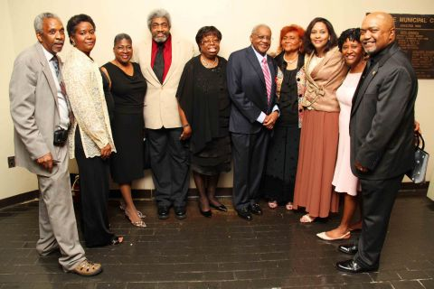

Slide 7
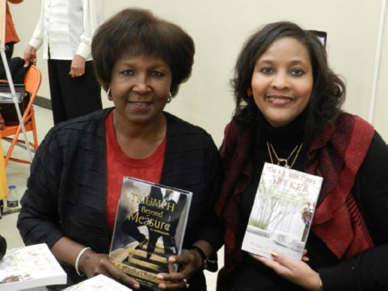

Slide 8


Slide 9
Dr. Michele R. Wright

